Slide 1
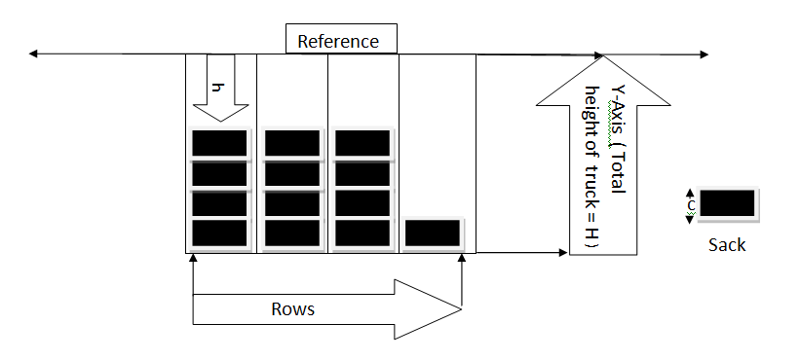
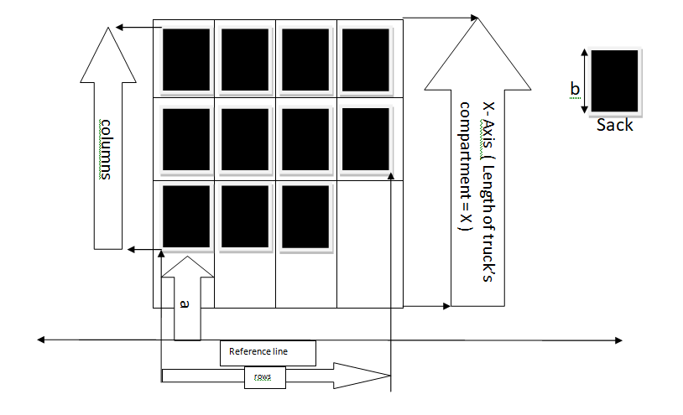
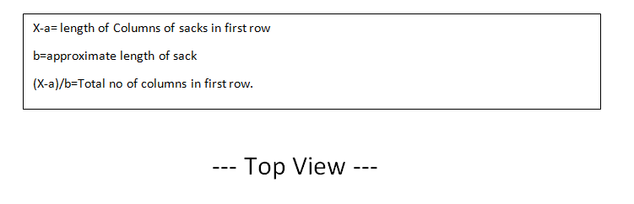
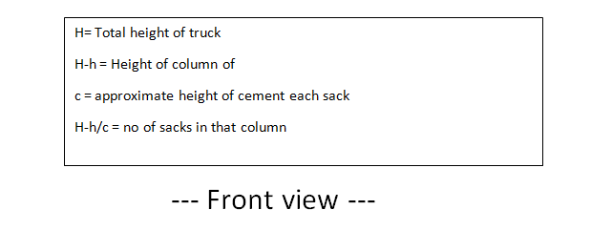
View Diagram :

Slide 2
Block/Flow Diagram :
Enter truck no. and initial manual sack count through
keyboard
Scanning of cement sacks from top using ultra sonic sensors array
Process the data from sensor using controller
Loaded truck
Controller will Verify the initial count with final count
Data base
Server
Wi-Fi module

